Slide 1
.
Nuclear’ s insecure future
Houses of Parliament
17 March 2016
”
Konzerthaus
Freiburg
By Dr David Lowry
senior research fellow, Institute for Resource and Security Studies, Cambridge, Ma. USA; member, Nuclear Waste Advisory Associates (UK); former director, European Proliferation Information Centre (EPIC), London and specialist researcher for Paul Flynn MP
from others”

Slide 2
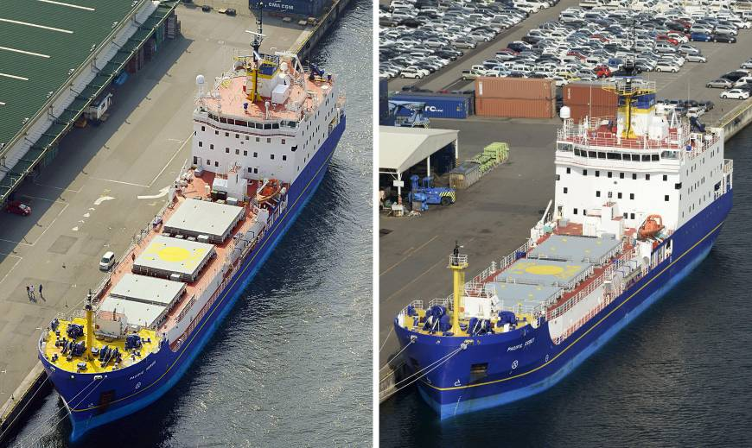
The Pacific Heron (left) and the Pacific Egret sit in Kobe on Saturday ahead of a 52-day voyage to transport 331 kg of toxic plutonium to the United States. | KYODO

Slide 3
Ships prepare to return 331-kg plutonium stash from Japan to U.S.
(Kyodo, March 6, 2016) http://www.japantimes.co.jp/news/2016/03/06/national/ships-prepare-return-331-kg-plutonium-stash-japan-u-s/#.VttLNv32aM9

Slide 4
“More than 10 years after the 9/11 hijackers considered flying a fully loaded passenger jet into a Manhattan area nuclear reactor, U.S. commercial and research nuclear facilities remain inadequately protected against two credible terrorist threats – the theft of bomb-grade material to make a nuclear weapon, and sabotage attacks intended to cause a reactor meltdown”
– according to a report prepared under a contract for the Pentagon by the Nuclear Proliferation Prevention Project (NPPP) at the University of Texas at Austin’s LBJ School of Public Affairs, 15 August 2013
“President Obama [has] stated that what kept him up at night was, ‘The prospect of a nuclear weapon going off in Manhattan…"
Democrat Senator Diane Feinstein from California, at Senate Appropriations Subcommittee on Energy and Water, April 9, 2014

Slide 5
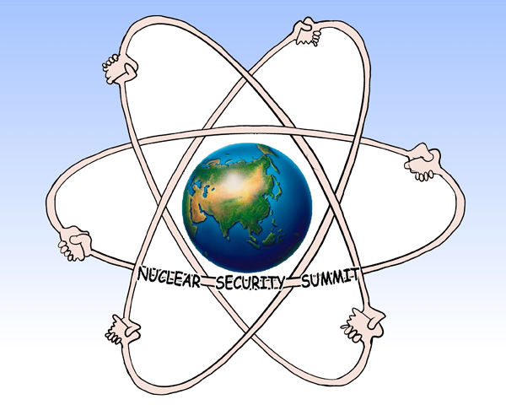

Slide 6
“Hundreds of foreign fighters, some with solid academic and educational backgrounds and intellectual knowledge, have joined the cause and continue to do so every day. Furthermore ISIL/Daesh’s success is based on an effective media strategy of looking at the utmost possible “news effect” of their attacks. Together with their access to high levels of funding, these three elements bear the real risk of the group turning into practice what up to now has been largely a theoretical possibility: to actually employ weapons of mass destruction or Chemical, Biological, Radiological or Nuclear (CBRN) material in terrorist attacks.
We might soon enter a stage of CBRN terrorism, never before imaginable..
- Wolfgang Rudischhauser, Director of the WMD Non-proliferation Centre, NATO Review 2015

Slide 7
Shape charge threats to transport flaks/casks
Visual demonstration of vulnerability of very robust containment to shape charge attack is more powerful than any number of words. In January 2008, there was a real demonstration test of a Raytheon Shaped Charge, Intended as the Penetration
(Precursor) Stage of a Tandem Warhead System. Below is the before and after sequence:
Before Test

Slide 8
After Test (viewed from the attacked face)

Slide 9
Islamic State want to inflict an “enormous and spectacular” terrorist atrocity on Britain and may have people trained to a paramilitary level to carry out attacks, a counter-terrorism chief has said.
Mark Rowley, a Metropolitan police assistant commissioner, said terrorists still wanted to kill soldiers or the police and now posed a real danger of attacking western lifestyle targets.

Slide 10

Our national security mismanagement
The Hindu, March 16, 2016
“National security management under the incumbent Bharatiya Janata Party (BJP)-led National Democratic Alliance (NDA) regime can best be described as the management of systemic inefficiency, with the institutional and ideational foundations of the country’s national security architecture having become weaker since the new government took charge almost two years ago. …:
Happymon Jacob is Associate Professor of Disarmament Studies at the Centre for International Politics, Organisation and Disarmament, School of International Studies, JNU
http://www.thehindu.com/opinion/lead/happymon-jacob-our-national-security-mismanagement/article8357414.ece

Slide 11
“In the area of nuclear security also, their (the nuclear regulators in UK and France) experience puts them at the forefront of current discussions, particularly in international forums.”
Franco-British Summit – 3 March 2016
Annex on a Comprehensive Franco-British Partnership on Civil Nuclear Energy
https://www.gov.uk/government/uploads/system/uploads/attachment_data/file/505178/UKFRS_Civil_Nuclear_Energy_2_March.pdf

Slide 12
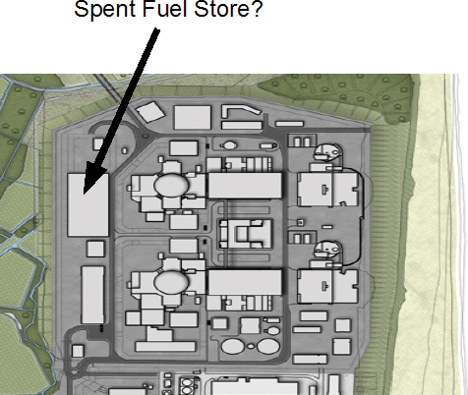
Location of Interim Spent Fuel Store at Sizewell.

Slide 13
Islamic State want to inflict an “enormous and spectacular” terrorist atrocity on Britain and may have people trained to a paramilitary level to carry out attacks, a counter-terrorism chief has said.
Mark Rowley, a Metropolitan police assistant commissioner, said terrorists still wanted to kill soldiers or the police and now posed a real danger of attacking western lifestyle targets.

Slide 14
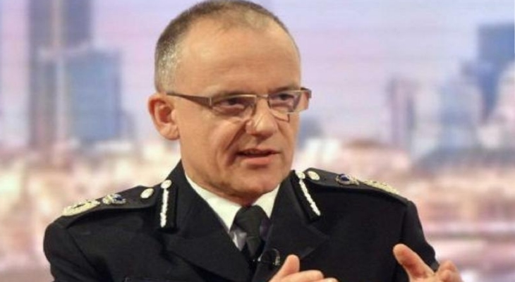
Mark Rowley, UK national head of counter-terrorism, says Isis has broadened its focus from police and military targets to something much bigger.
Guardian, Tuesday 8 March 2016

Slide 15
“We cannot afford to wait for an act of nuclear terrorism before working together to collectively improve our nuclear security culture, share our best practices, and raise our standards for nuclear security…”
Rose Gottemoeller
US Under Secretary of State for Arms Control and International Security
- March 16, 2016

Slide 16
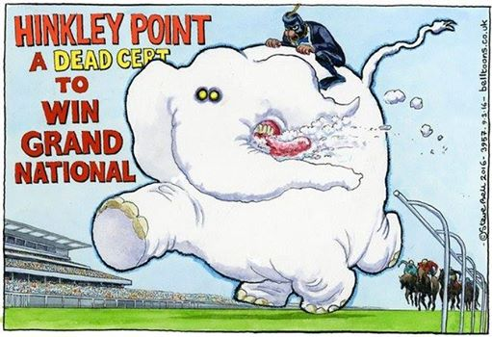

Slide 17


