Slide 1
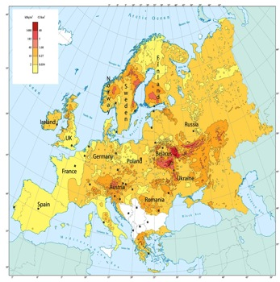
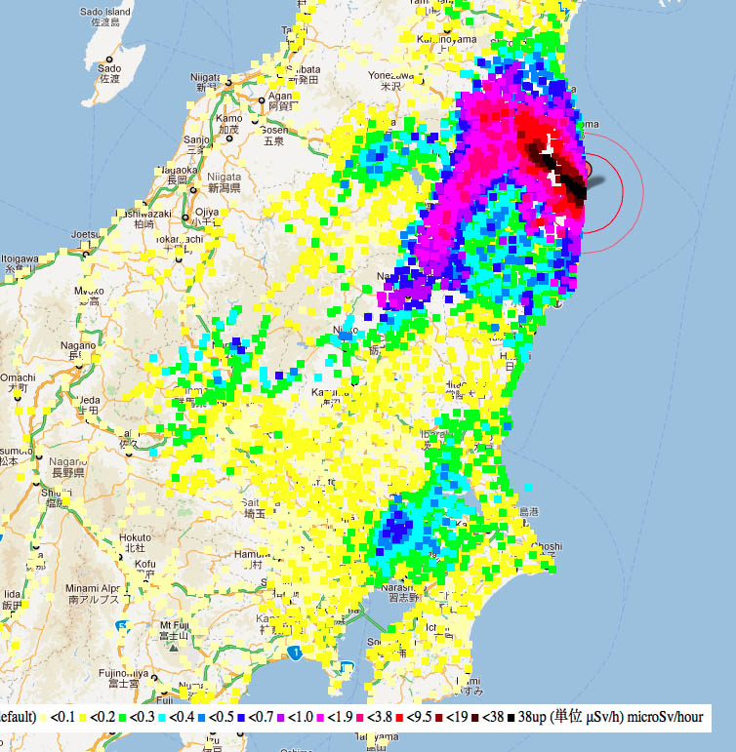
The Effects of Ionizing Radiation on Non-Human Biota:
Lessons from Chernobyl and Fukushima
Timothy A. Mousseau, PhD
Professor of Biological Sciences
University of South Carolina
Tokyo (36M people)

Slide 2
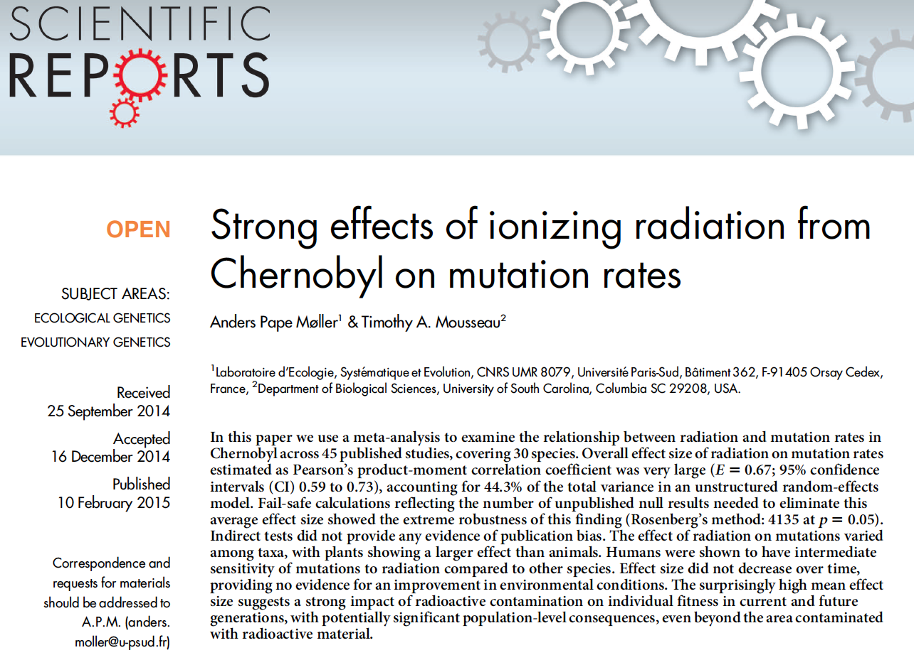

Slide 3
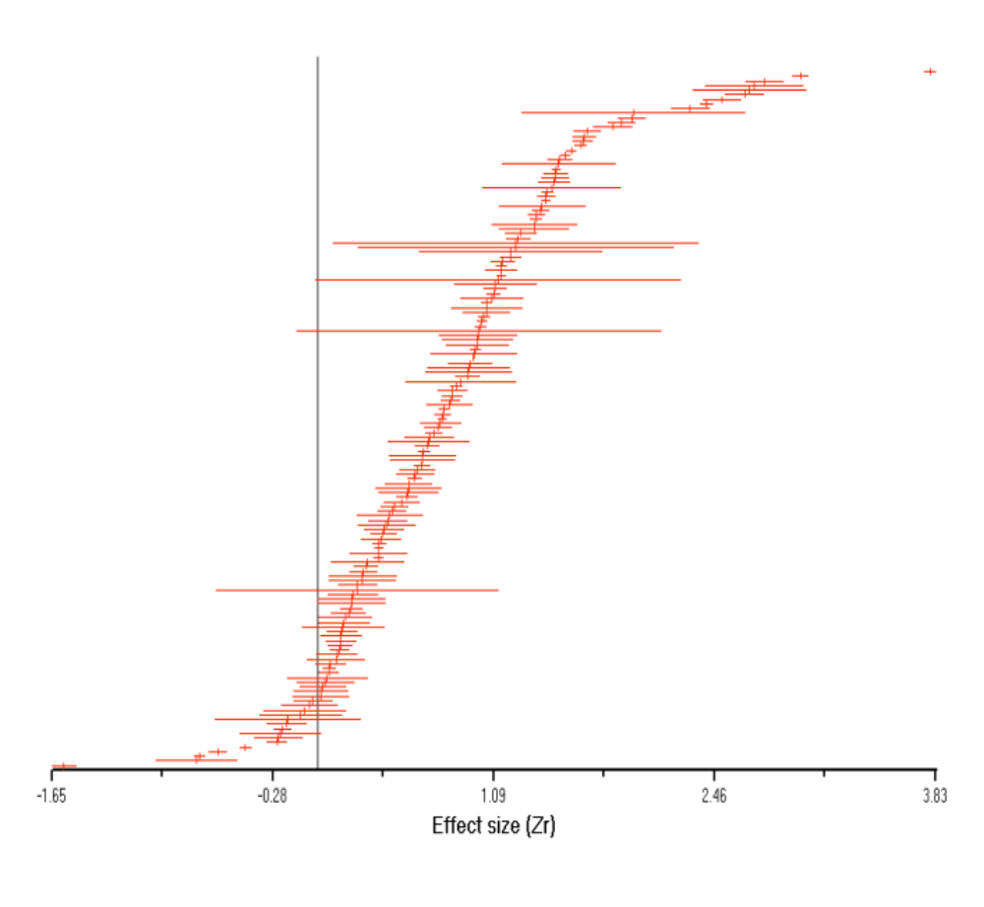
Chernobyl: Radiation and Mutation, a Meta-Analysis
E = 0.67; 95% CI 0.59 to 0.73; N = 151
R2 = 0.44
A. P. Møller, T. A. Mousseau. 2015. Strong effects of ionizing radiation on mutation rates from Chernobyl. Nature Scientific Reports .

Slide 4
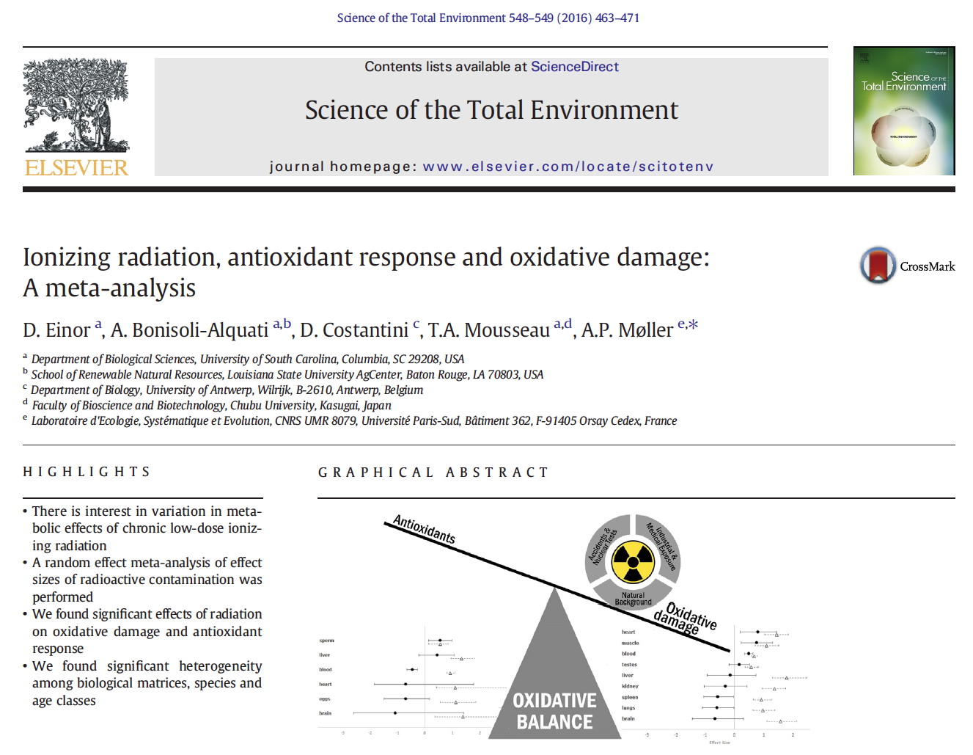

Slide 5
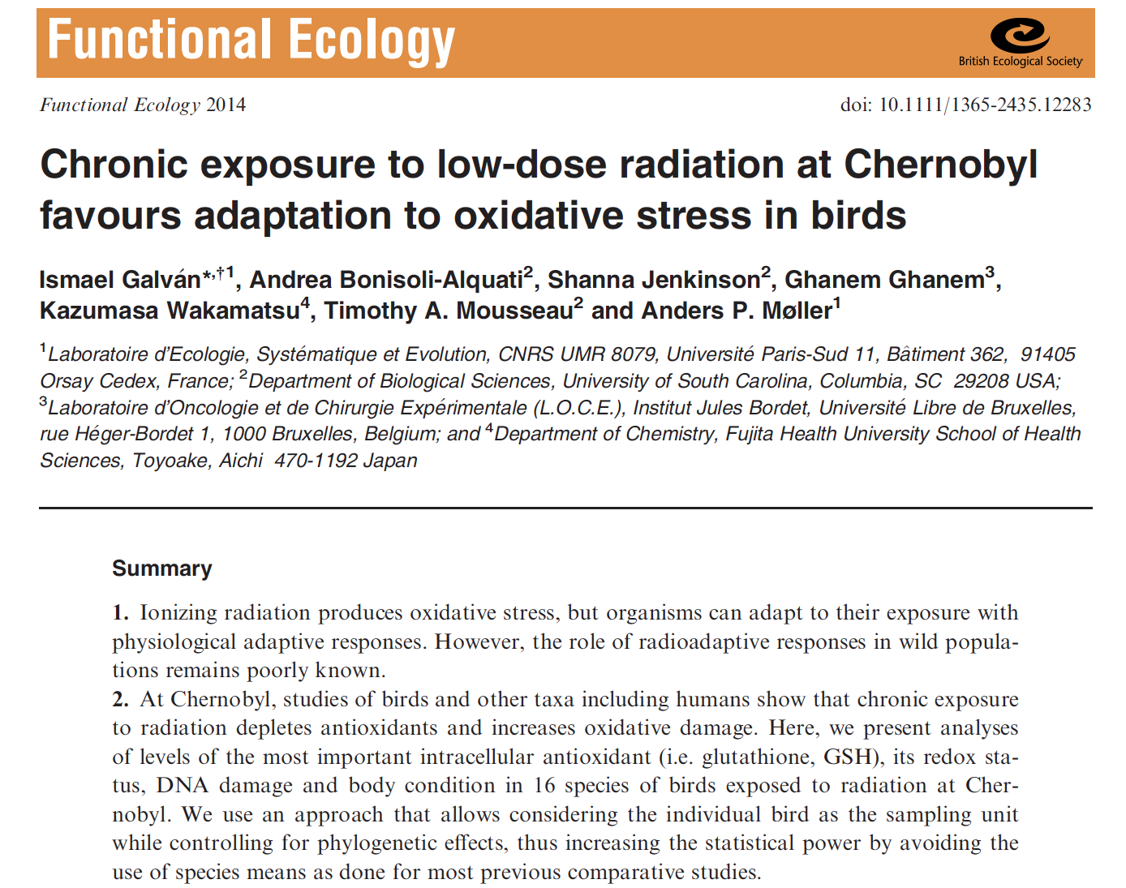

Slide 6
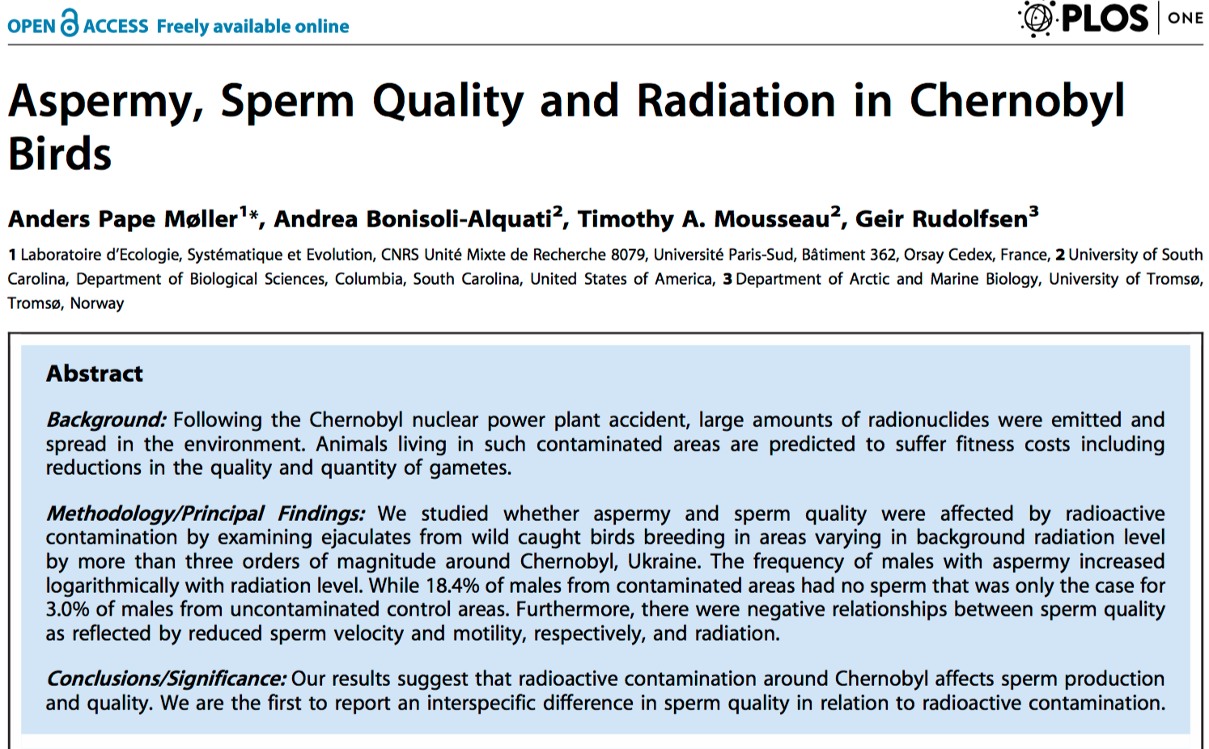
Citation: Møller AP, Bonisoli-Alquati A, Mousseau TA, Rudolfsen G (2014) Aspermy, Sperm Quality and Radiation in Chernobyl Birds. PLoS ONE 9(6): e100296. doi:10.1371/journal.pone.0100296

Slide 7
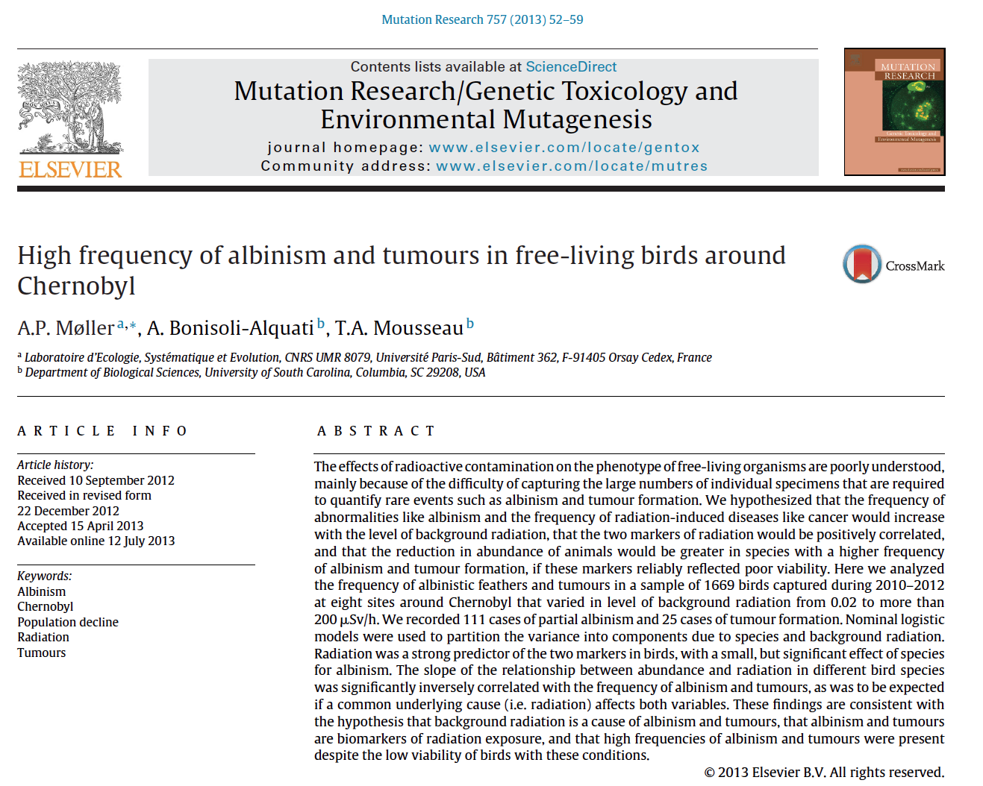

Slide 8
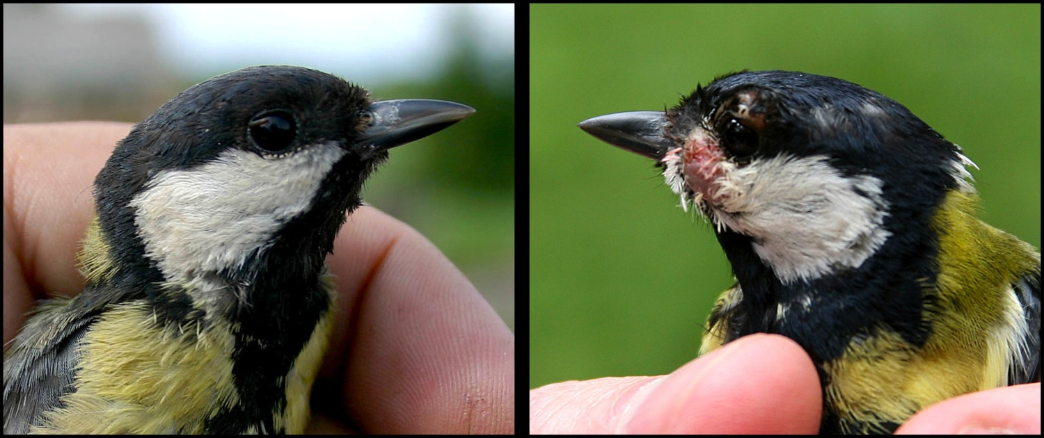
Great tit, Parus major
Tumor around eye

Slide 9
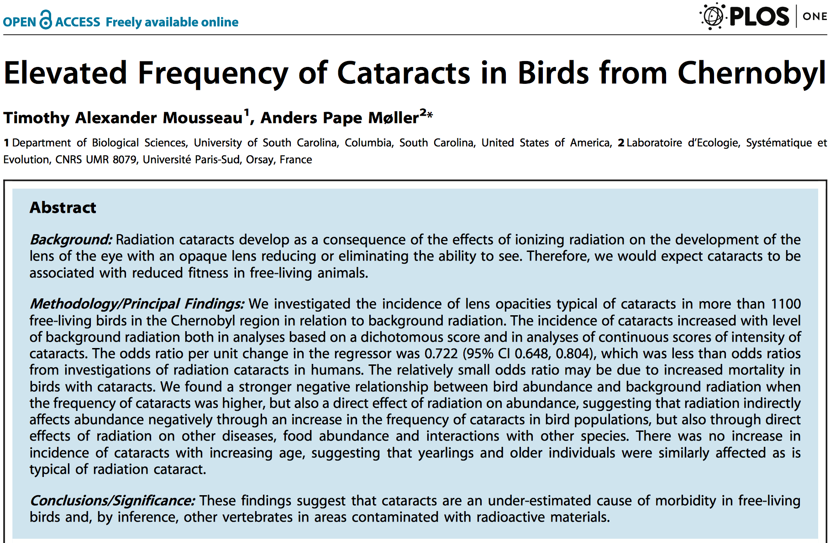

Slide 10
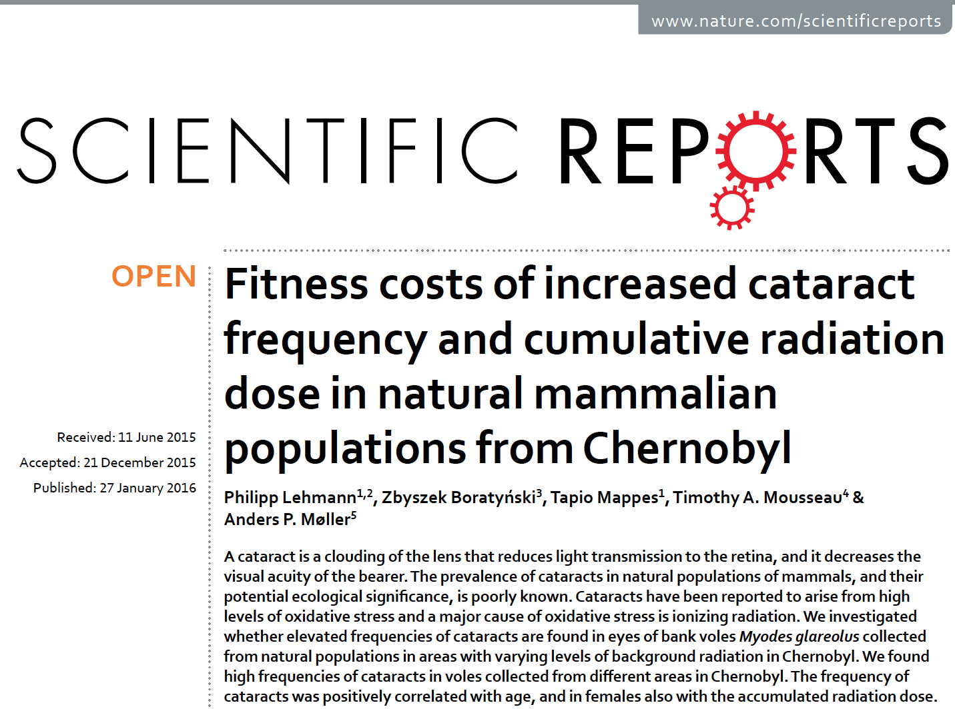
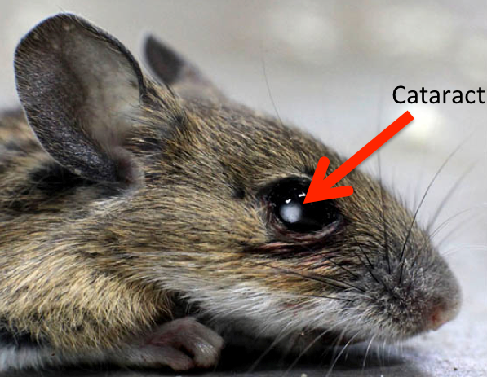

Slide 11
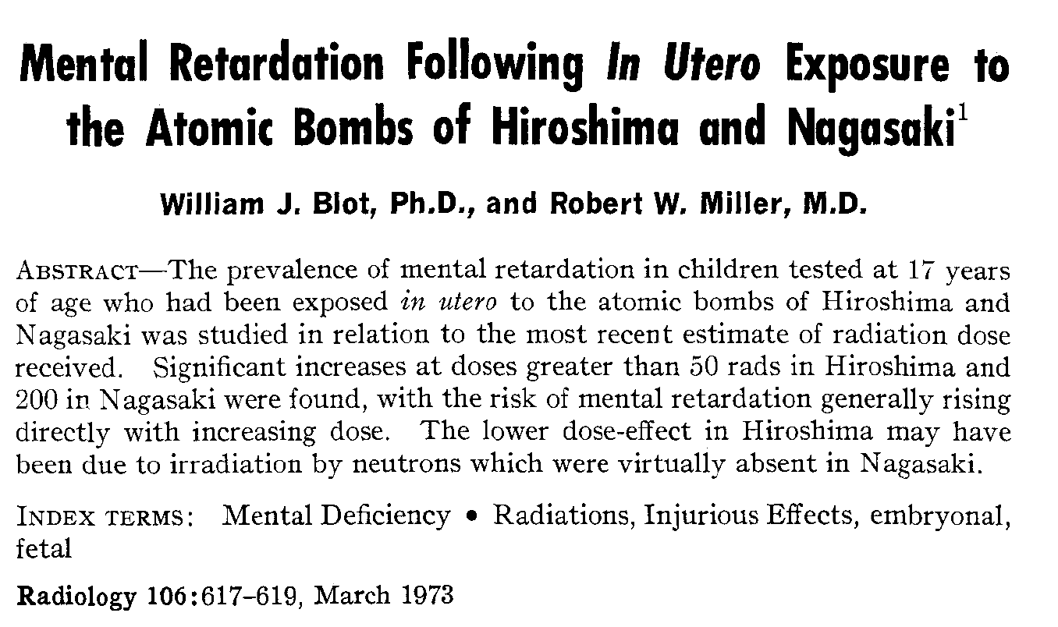

Slide 12
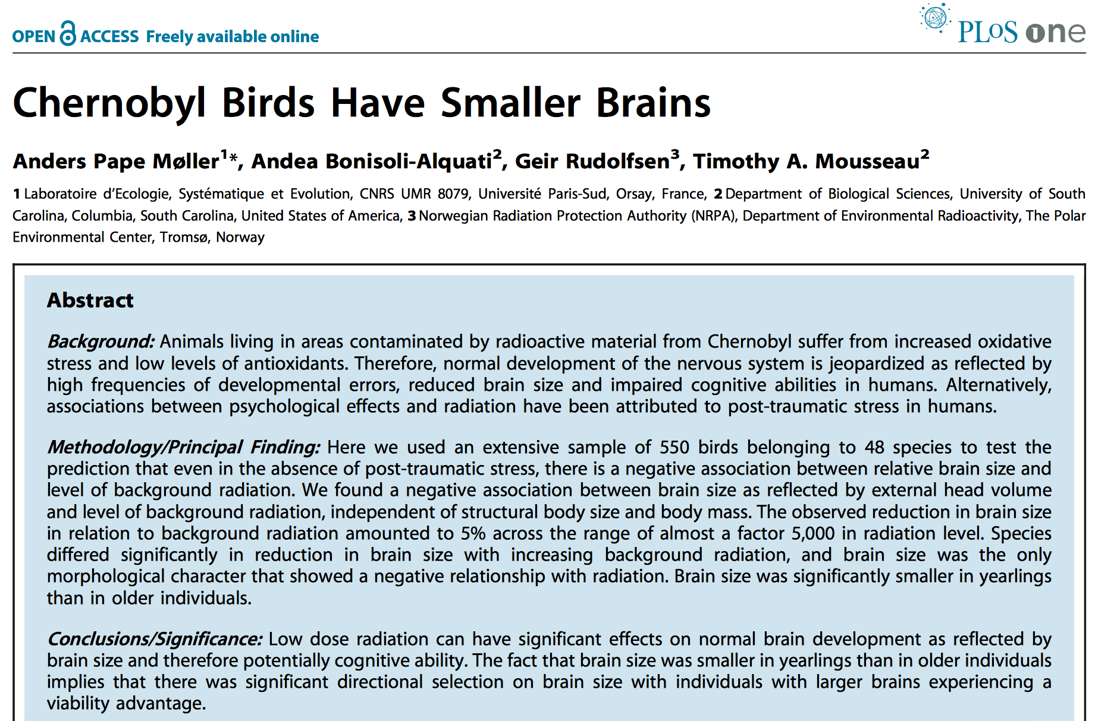

Slide 13
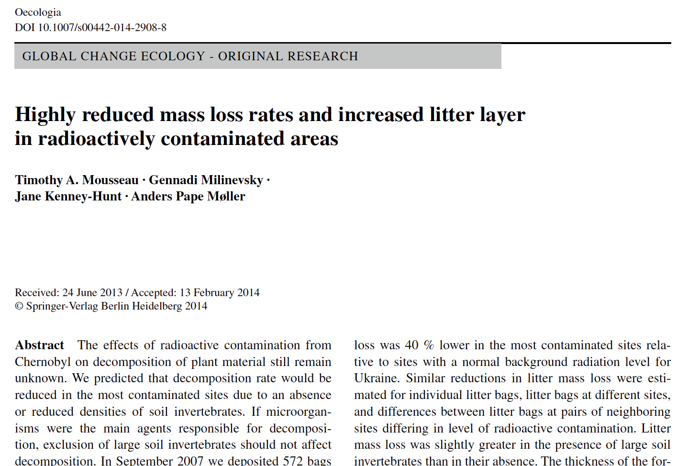
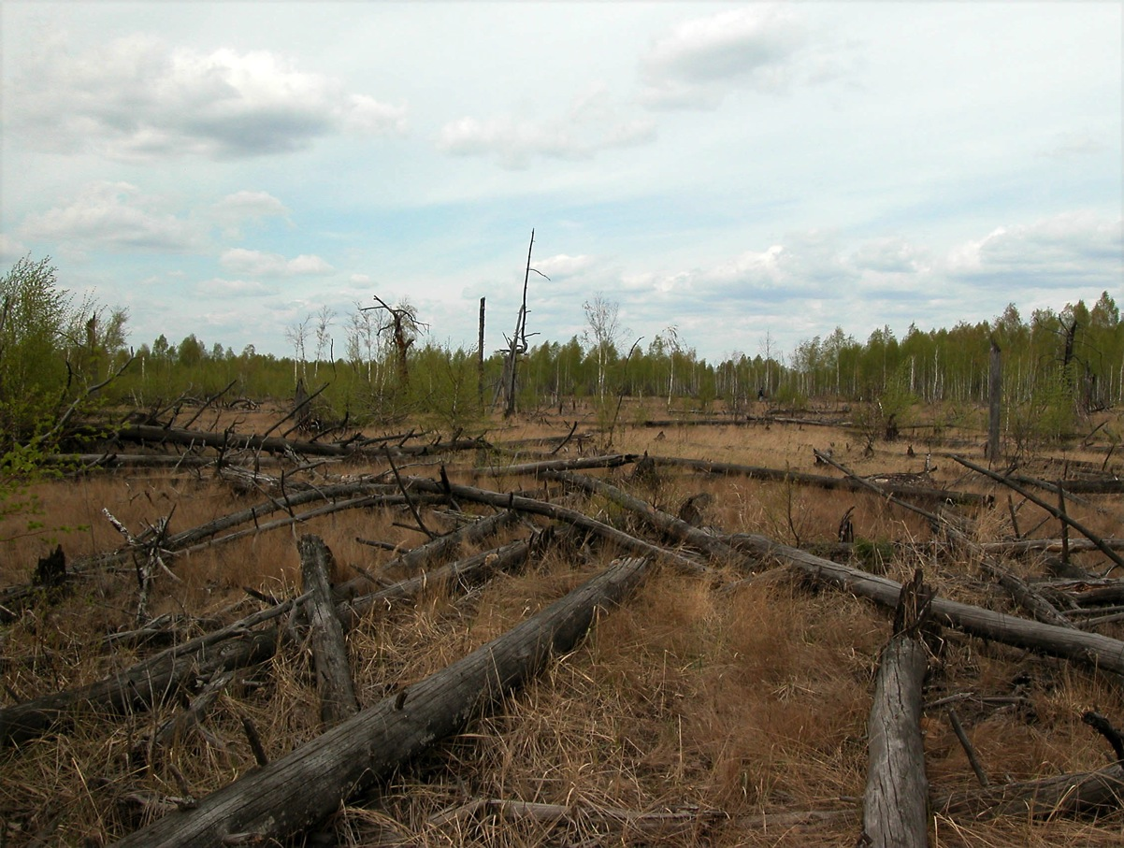

Slide 14
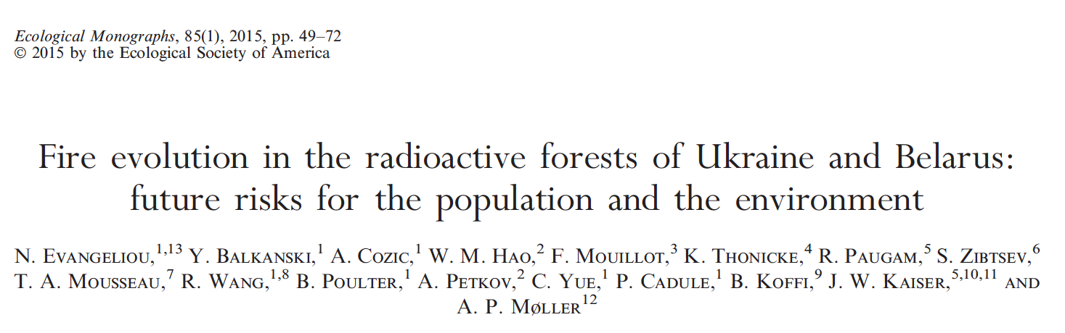
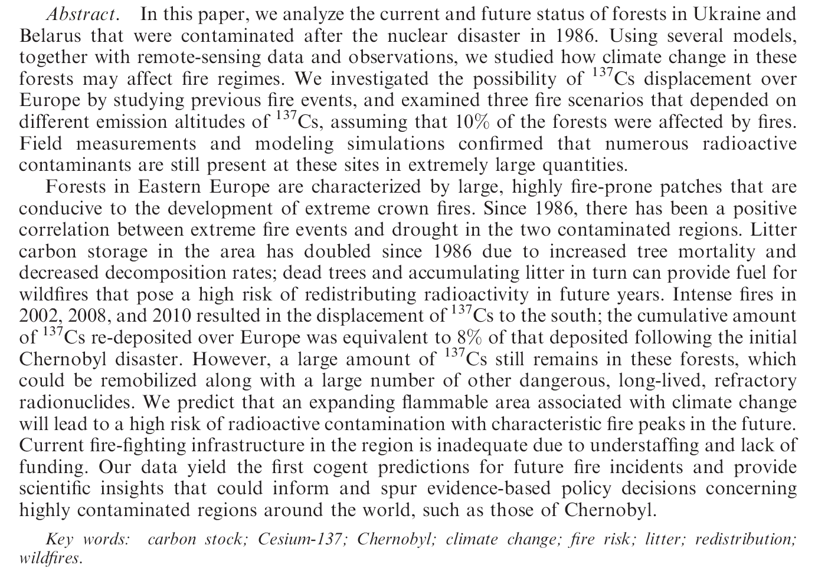

Slide 15

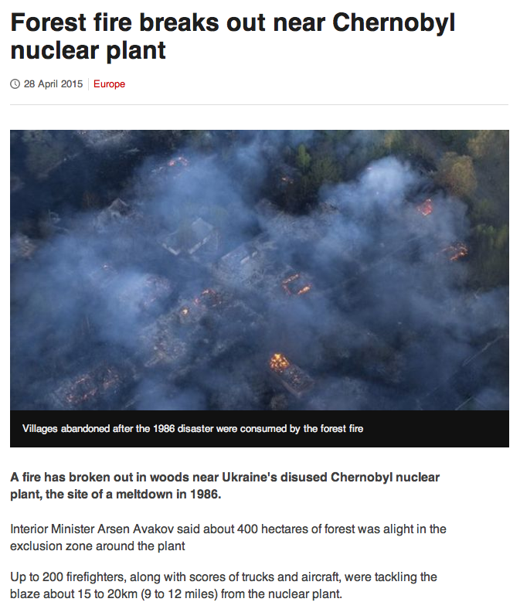

Slide 16
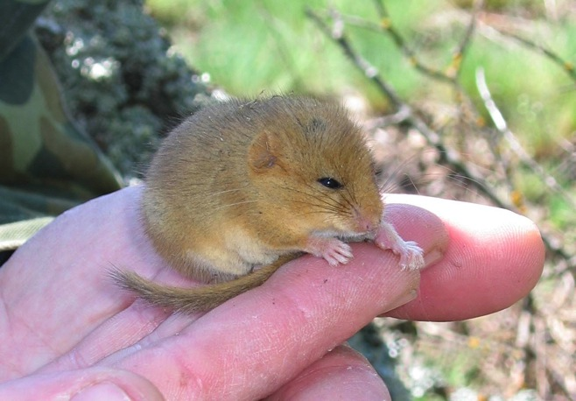
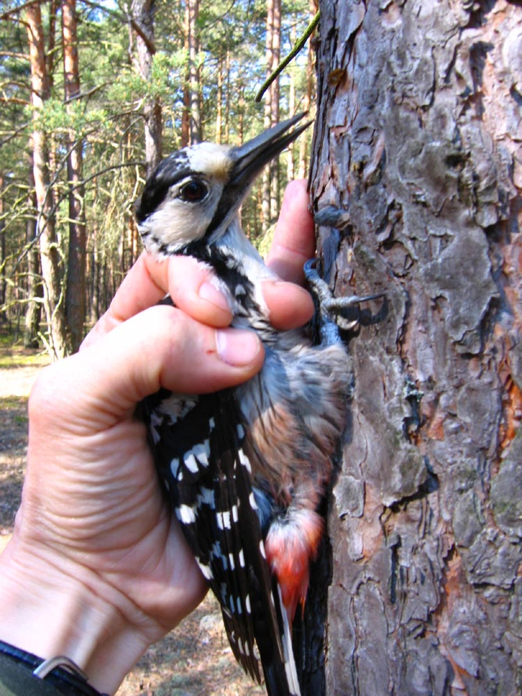
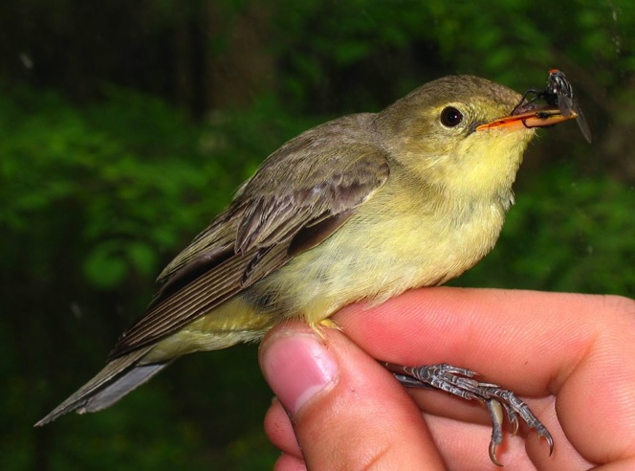
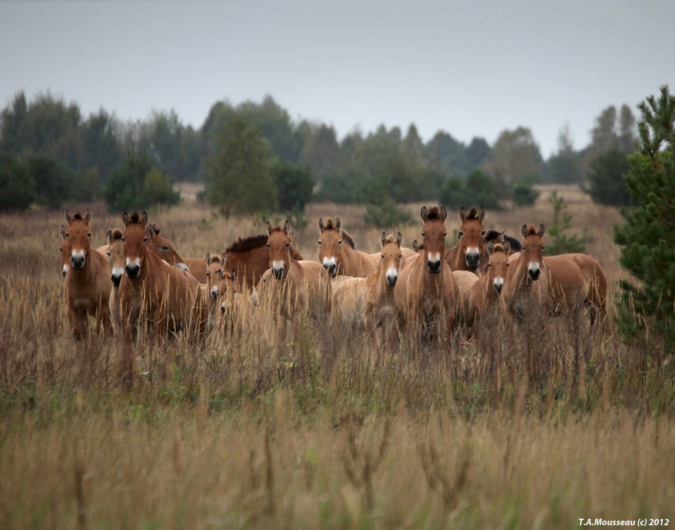
How is Animal Abundance and Diversity Affected by Radiation?

Slide 17
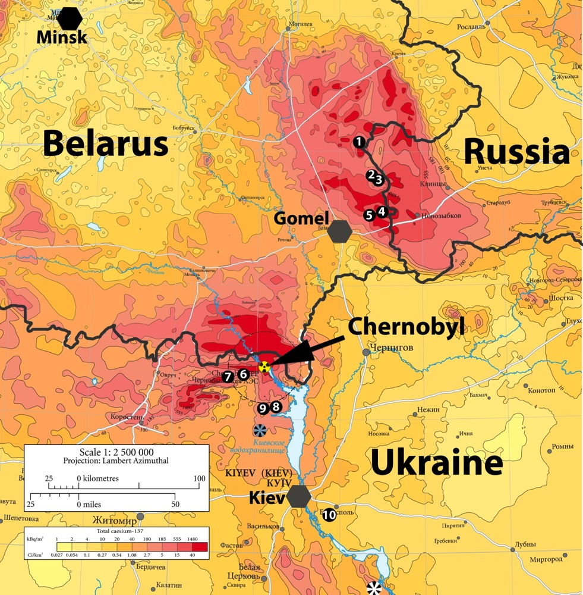
Most of our research includes areas of the highest contamination in addition to control areas. Patchiness of deposition permits disentanglement of radiation, distance from source, and other environmental factors that influence abundance and biodiversity.
- 896 bird and insect surveys from about 300 locations in Ukraine and Belarus
Control Populations:
Italy (Milan)
Spain (Badajoz)
Denmark (Aalborg)
Ukraine

Slide 18
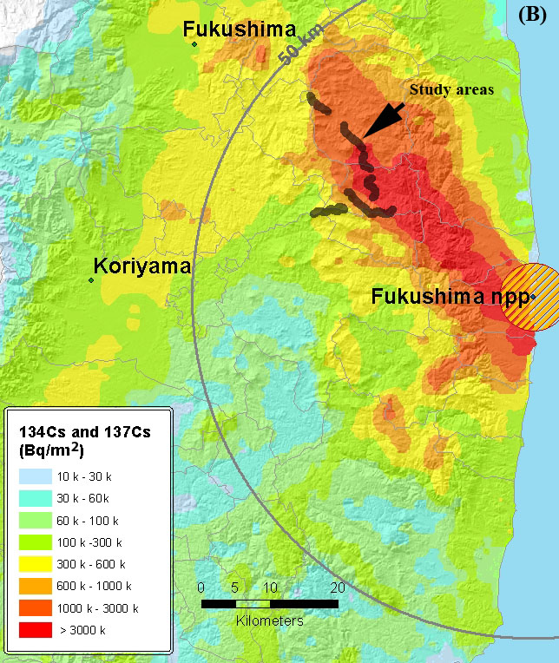

Surveys of birds and insects from 400 discrete locations, 1500 inventories in total to date.

Slide 19
Massively Replicated Biotic Inventories
(1500 in Fukushima, 896 in Chernobyl)
+
Measures of Multiple Environmental Variables
(e.g. meteorology, hydrology, geology, plant community, Habitat type,
land use history, plant coverage amount and type, altitude,
meteorological conditions, time, date, distance to nearest water source, etc)
+
Field Measures of Residential Radiation Levels
+
GIS
+
Multivariate Statistics
=
Predictive Models of Radiation Effects on Populations

Slide 20
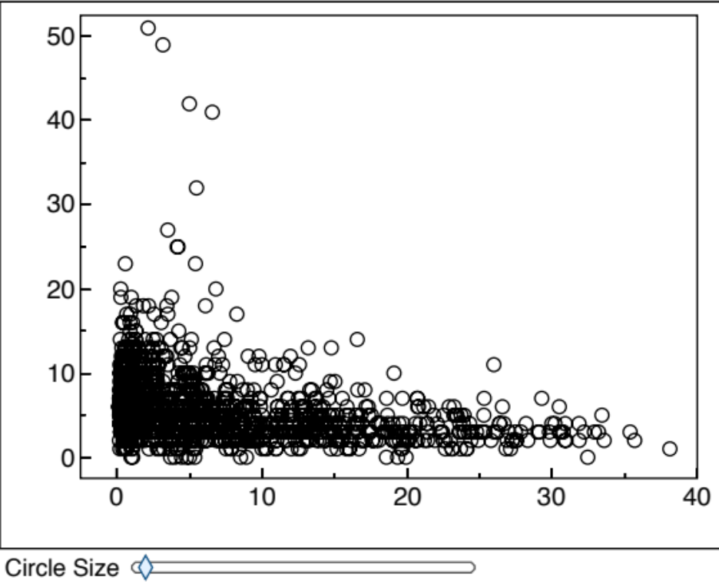
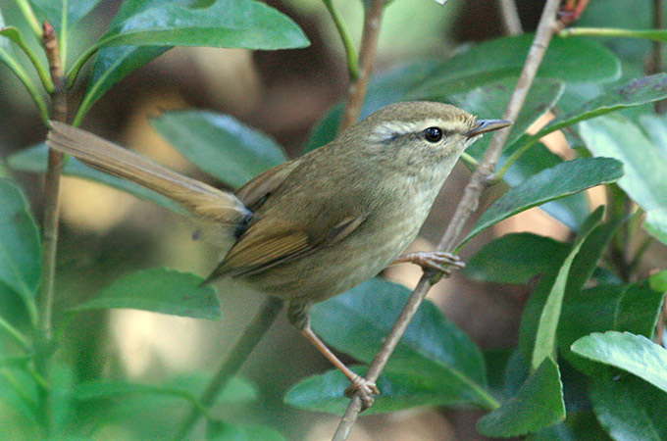
Abundance and radiation – Fukushima Birds 2011-14
No. birds
χ² = 241.93, P < 0.0001
Background radiation (μSv/h)

Slide 21
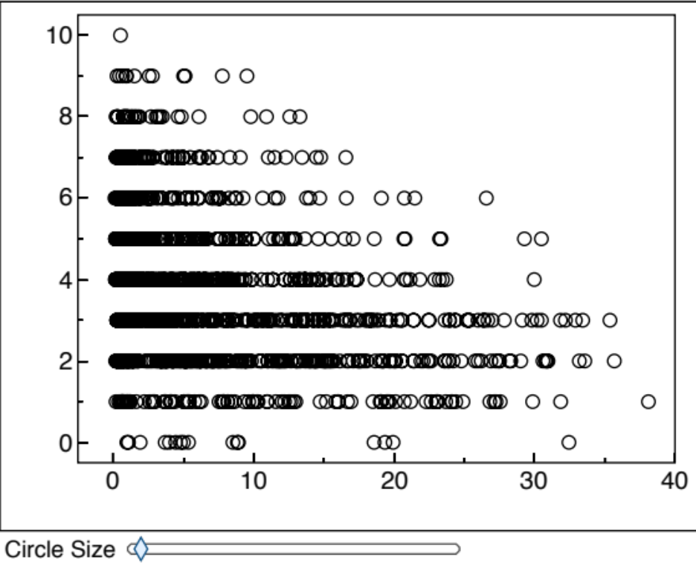
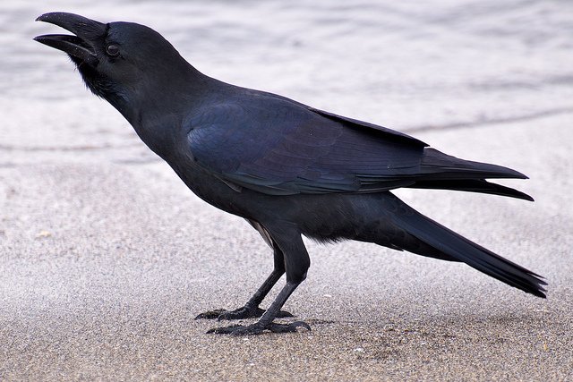
Species richness and radiation - Fukushima Birds 2011-14
χ² = 100.30, P < 0.0001
No. species
Background radiation (μSv/h)

Slide 22
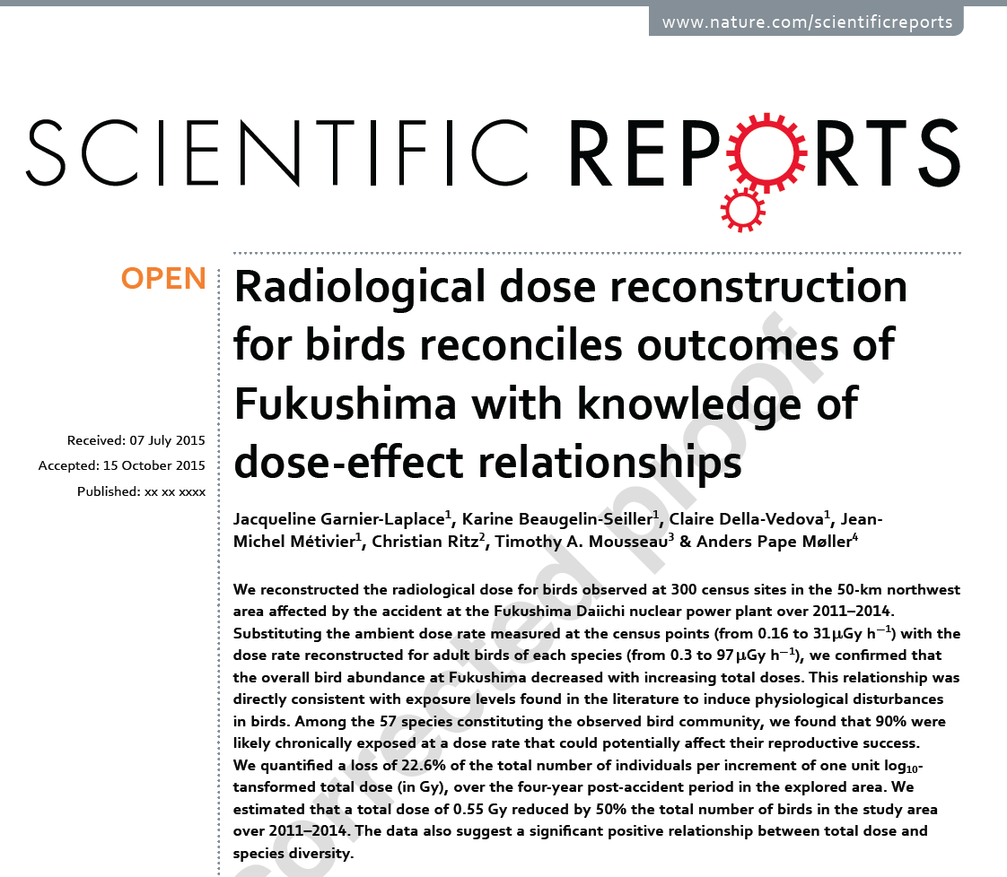

Slide 23
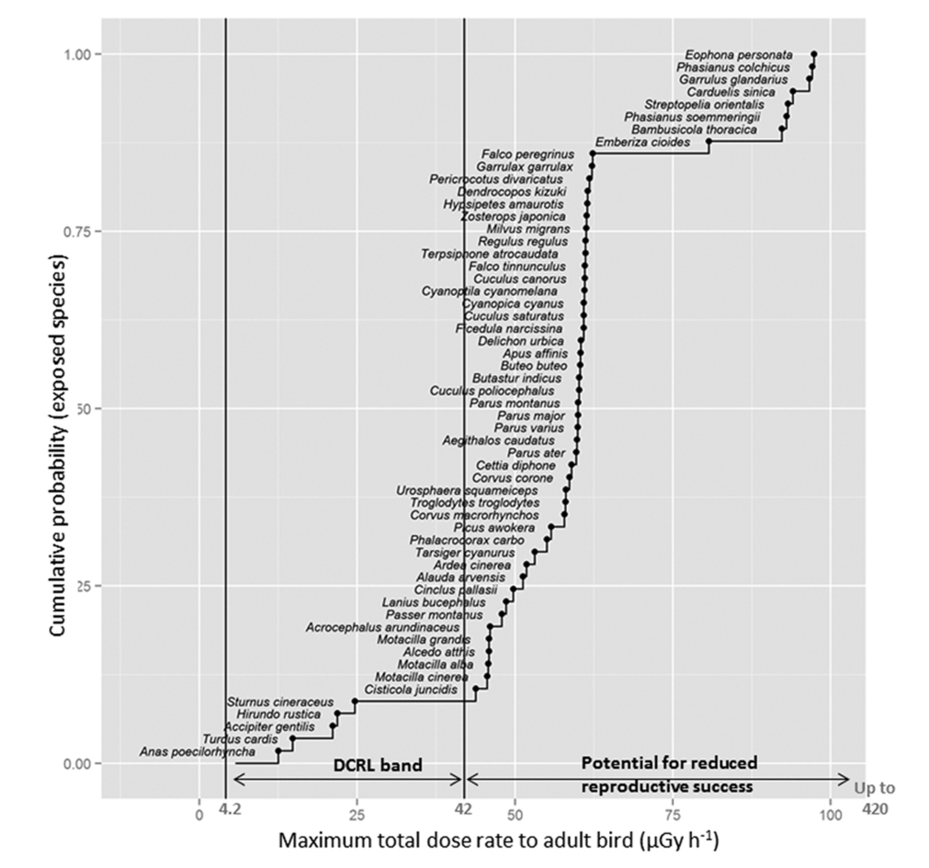
Dose rate to most birds was high enough to cause significant reduction in reproduction
Fukushima 2011-14

Slide 24
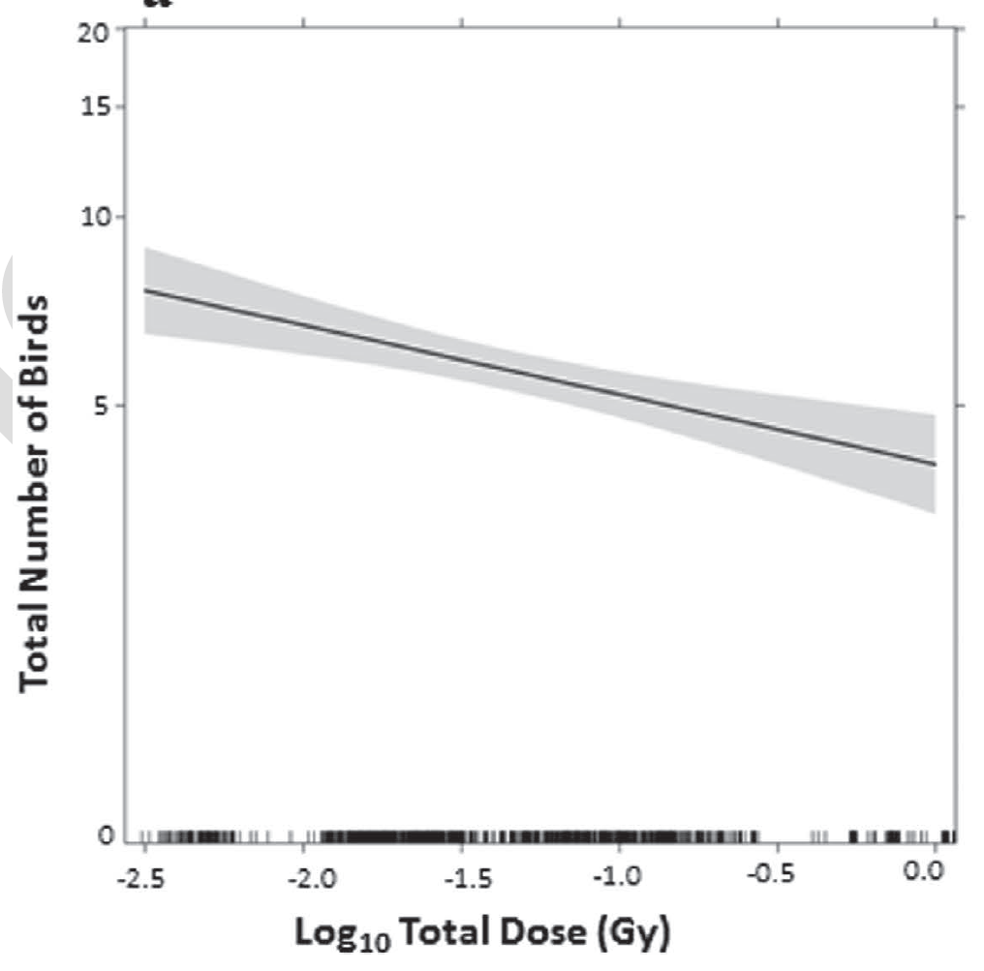
(z = −4.06, p < 0.0001; unstandardised partial slope (SE) = −0.256 (0.063)
Fukushima
2011-2014

Slide 25
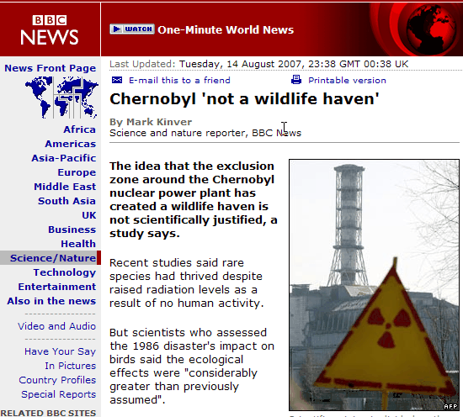

Slide 26
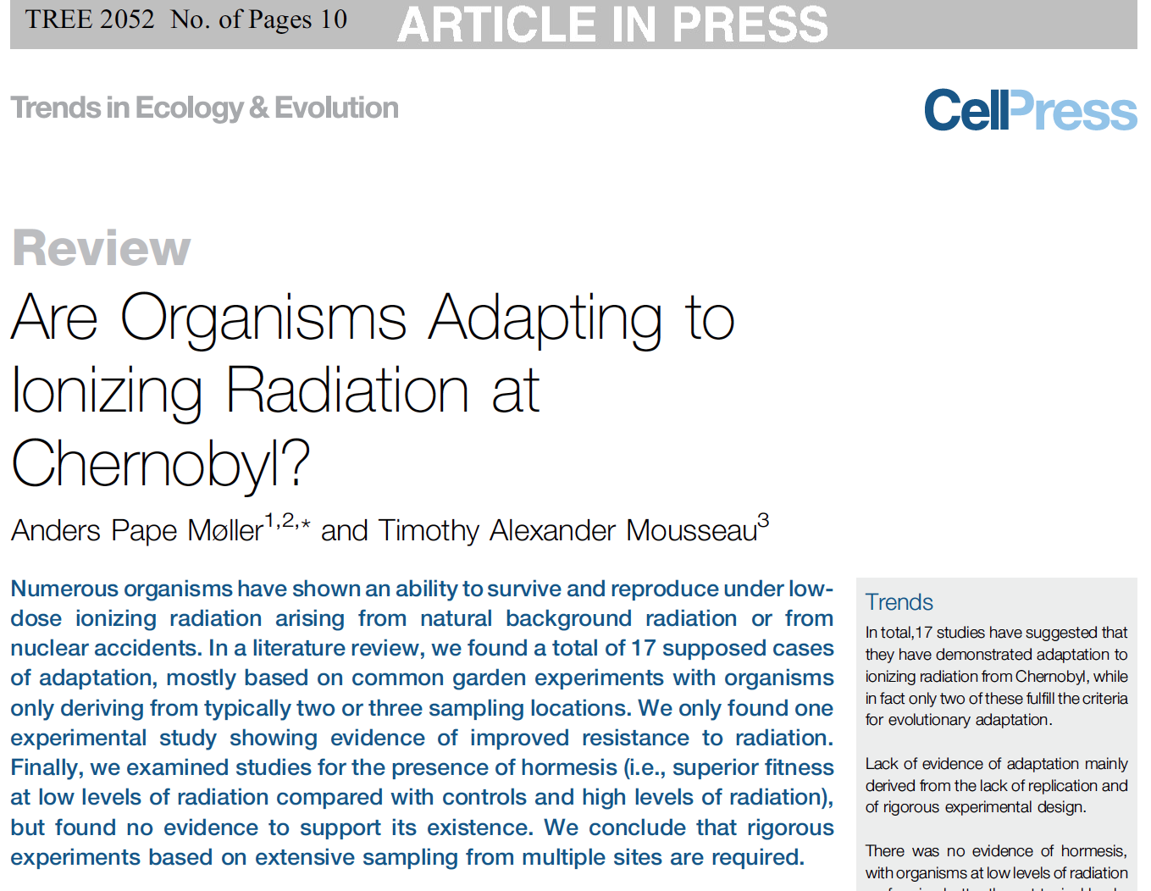

Slide 27
Major Findings from studies of Wildlife in Chornobyl:
Most organisms studied show significantly increased rates of genetic damage in direct proportion to the level of exposure to radioactive contaminants
Many organisms show increased rates of deformities and developmental abnormalities in direct proportion to contamination levels
Many organisms show reduced fertility rates…..
Many organisms show reduced life spans……
Many organisms show reduced population sizes…..
Biodiversity is significantly decreased…… many species locally extinct.
More speculative, but potentially larger impact:
Mutations are passed from one generation to the next, and show signs of accumulating over time.
Mutations are migrating out of affected areas into populations that are not exposed (collateral damage).

Slide 28
What does this all mean?
Contrary to governmental and media reports, there is now an abundance of information demonstrating consequences (i.e. injury) to individuals, populations, species, and ecosystem function stemming from the low dose radiation due to the Chornobyl and Fukushima disasters.
Effects appear to be proportional to dose.
There is no evidence for any kind of threshold below which effects are not seen.

Slide 29
What should be done?
We are calling for funding of in international scientific effort to fully document the range of biological consequences related to low-dose-rate radiation in the environment.

Slide 30
What should be done?
Such an effort must be led by independent scientists who are committed to a rigorous, unbiased analysis of the present situation with the goal of predicting long term impacts of radiation for the environment.

Slide 31
Acknowledgments – My Deepest Thanks
In Ukraine:
Marina Naboka
Alexandra Kravets
Eugenia Stepanova
Alexander Peklo
Eugene Pysanets
Gennadi Milinevsky
Iryna Kozeretska
V. Bezrukov
Va. Shestopalov
D. Grodzinsky
I. Chizhevsky
O. Bondorenko
S. Kireev
S. Gaschak
S. Ruskovski
L. Milinevski
Myron Stachiw
S. Serga
Andrew Rozhok
V.Y. Vdovenko
In USA:
Andea Bonisoli-Alquati
Daniel Einor
Kate Brown
Wilfried Karmaus
Bruce Coull
Erik Svendsen
Neal Nelson
Lynn Schoolfield
Mike Wyatt
Travis Glenn
Steve Featherstone
John Palms
Harris Pastides
Mary Anne Fitzpatrick
Bill Murray
Hilton Smith
Heather Preston
Jane Kenney-Hunt
Shane Welch
Shanna Ostermiller
De Anna Beasley
Jayme Waldron
Tomoko Steen
Dave Tedeschi
Japan:
Kaoru Ueno
Masahiro Natsuhori
M. Fukumoto
Takao Kangawa
Marian Moriguchi
Hidekatsu Ouchi
A. Kanno
Tetsiju Imanaka
Kazko Kawai
David McNeill
Azby Brown
Ailleen Mioko Smith
Akira Kawasaki
Atsushi Hagiwara
Keisuke Ueda
Tomoko Nakanishi
Satoe Kasahara
Shin Mitsui
Kensho Kawatsu
Isao Nishiumi
H. Suzuki
K. Ishida
H. Somiya
H. Terai
N. Kobayashi
K. Koyama
W. Kitamura
K. Wakamatsu
Rest of The World:
Anders Pape Møller
Gier Rodilfsen
Nicola Saino
Florentino de Lope
Peter Surai
Keith Hobson
Tibor Szep
Filiz Karadas
Andreas Erhardt
Pete Van Ness
Alexey Yablokov
Niko Evangeliou
Tapio Mappes
Z. Boratynski
J. Garnier-Laplace
P. Lehmann
M. Ruiz-González
G. Á. Czirják
S. Aliyu
T. Giraud
P. Heeb
H. Caldicott
Ismael Galvan
Ghermosell
T. Laskemoen
J.T. Lifjeld
J. Balbontín

